Slide 1
SALES PERFORMANCE ANALYSIS DASHBOARD
POWER BI BUSINESS INTELLIGENCE PROJECT
PREPARED BY
ONWUSA, CHUKWUDI
TOOLS USED
POWER BI | POWER QUERY | DAX | EXCEL | Data Modeling

Slide 2
PROJECT OVERVIEW
OVERVIEW
This project analyses sales transactions to evaluate business performance, customer behaviour, product profitability, and order trends.
The objective of this project is to transform raw sales data into actionable insights that support data driven decision-making.
SCOPE
Revenue analysis
Profitability Analysis
Customer Analysis
Product Analysis
Order Analysis

Slide 3
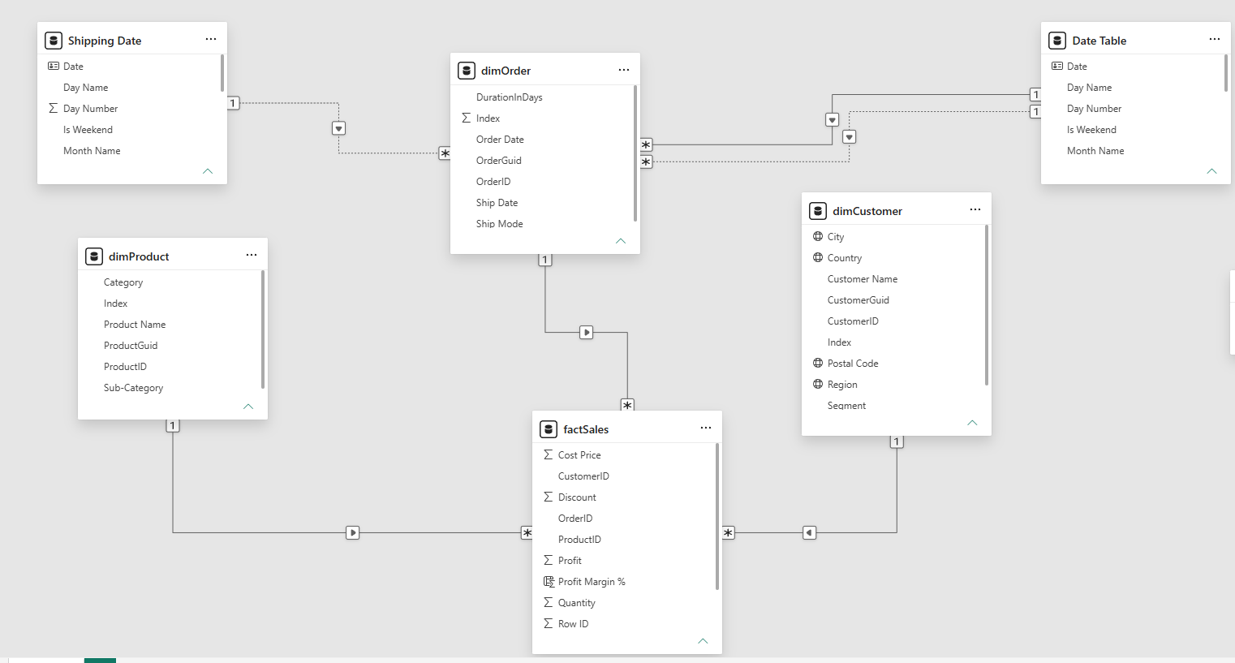
DATASET OVERVIEW
DATASET SUMMARY DATA MODEL
KEY FIELDS
Order date
Customer
Product
Sales
Profit
Quantity
This dataset was fetched as a flat table, but later disintegrated into two 3 dimension table product, customer and order, and 1 fact table – sales table. Then merged integrated back using relationship of pk and fk
METRIC | VALUE
Total Records | 9,774
Total Revenue | 2,287,322.33
Total Profit | 284,462.62
Total Customers | 4,865
Total Products | 1,850
Total Orders | 4,961

Slide 4
BUSINESS PROBLEM
BUSINESS QUESTIONS
The organization wants to understand
What is the overall sales performance?
Who are the most valuable customers?
Which product(s) drive revenue and customers?
How are orders being fulfilled?
How has performance changed over time?
Which areas requires management attention?
EXPECTED OUTCOME
Provide a dashboard for monitoring business performance and identifying growth opportunities.
Sales Overview: showing how the business is doing.
Customers: showing who are buying.
Products: Showing what is selling.
Order: Showing how are orders been fulfilled.

Slide 5
KPIs DEFINED
OVERVIEW KPIS | DEFINITION
Total Transaction | Total unique no of transaction
Total Revenue | Total revenue generated
Total Profit | Revenue less cost
Profit Margin | The % the business retains as profit for every single money spent.
Total Customers | Total unique no of customers
Total Product | Total unique no of products
Total Order | Total unique no of orders
Avg Order Value | The list amount a customer spends on a single order.
MOM, YOY | Month Over Month and Month of Month for Revenue, Profit, order and customers
CUSTOMER KPIS | DEFINITION
Repeat customers | Customers that repeated
Unrepeated customers | Customers that purchased only once
RCR (Repeat Customer Rate) | The rate at which customers repeats
ARPC | Average Revenue per Customer
APPC | Average profit per Customer
CRR | Customer Retention Rate
PRODUCT KPIS | DEFINITION
Total product category | Total product category
Total product sub category | Total product sub category
Repeat products | Products purchased > 1
Un-repeat products Margin | Products purchase < 2
Top Category | Top product category by revenue
ORDER KPIS | DEFINITION
Total Quantity | Total quantity ordered
Items per order | Average Items per order
Average order per value | Average order per value
Average order value | Lowest amount spent per order
Purchasing frequency | How often customers buy things

Slide 6
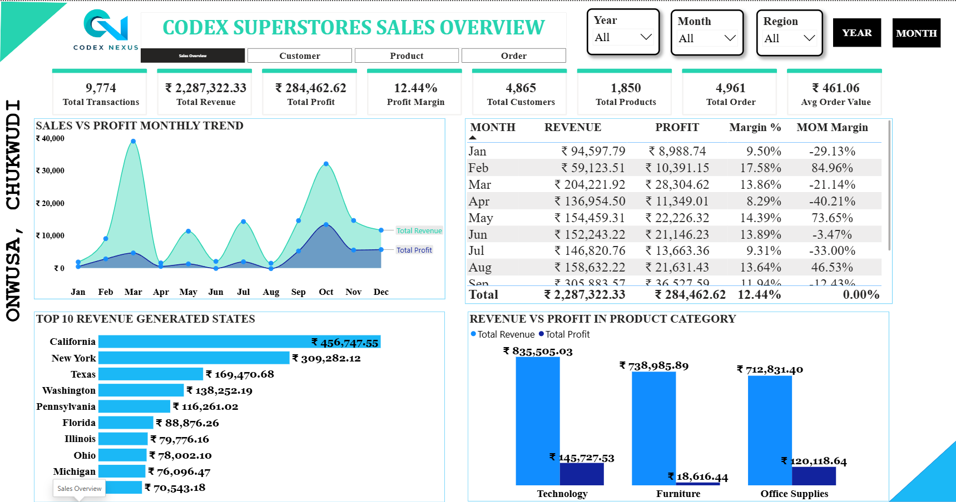
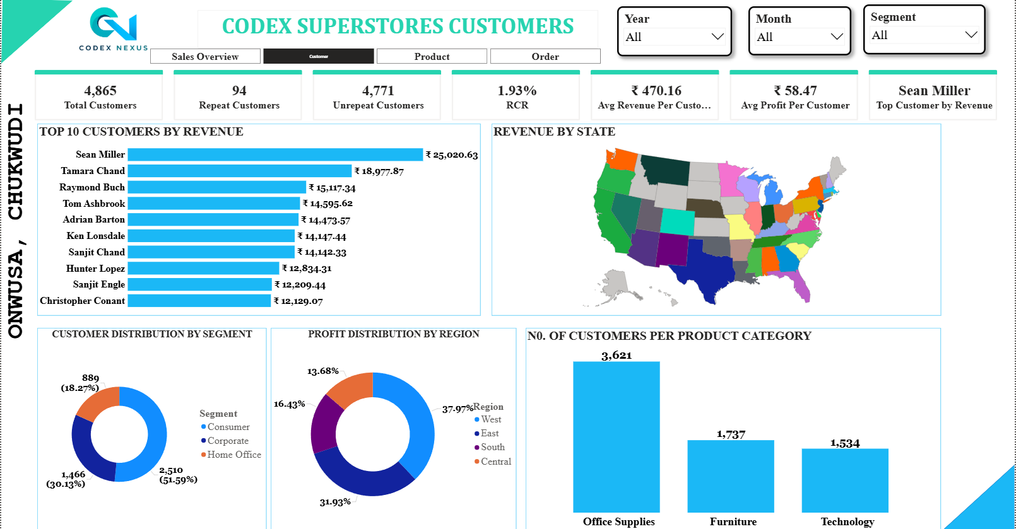
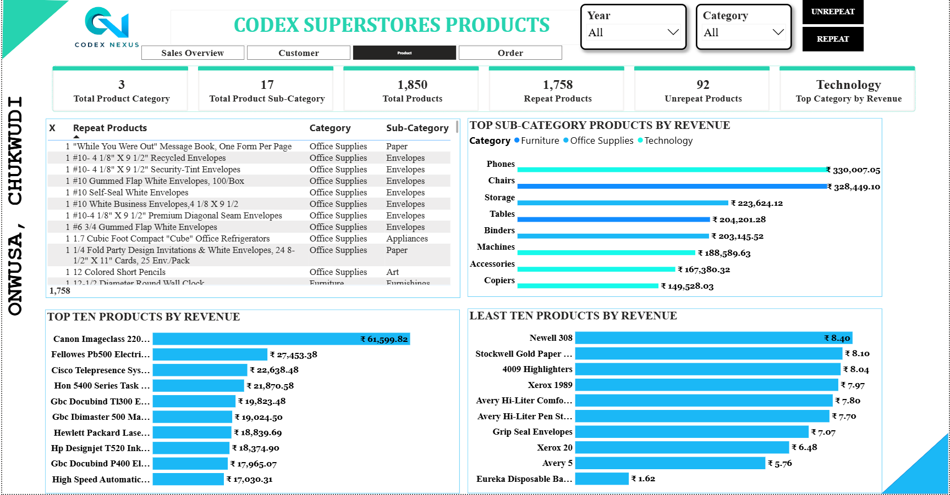
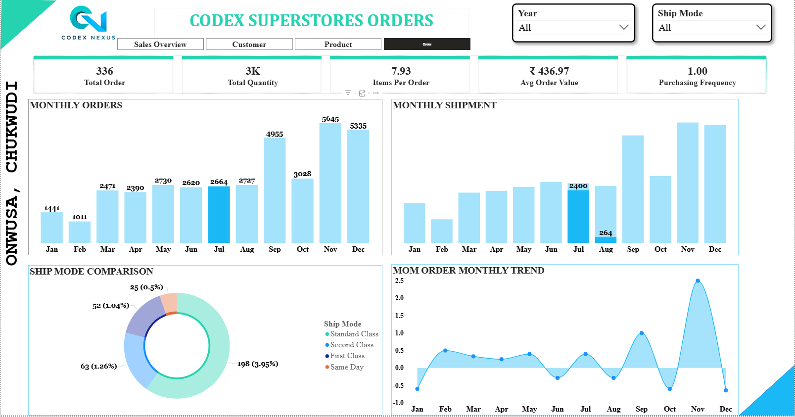
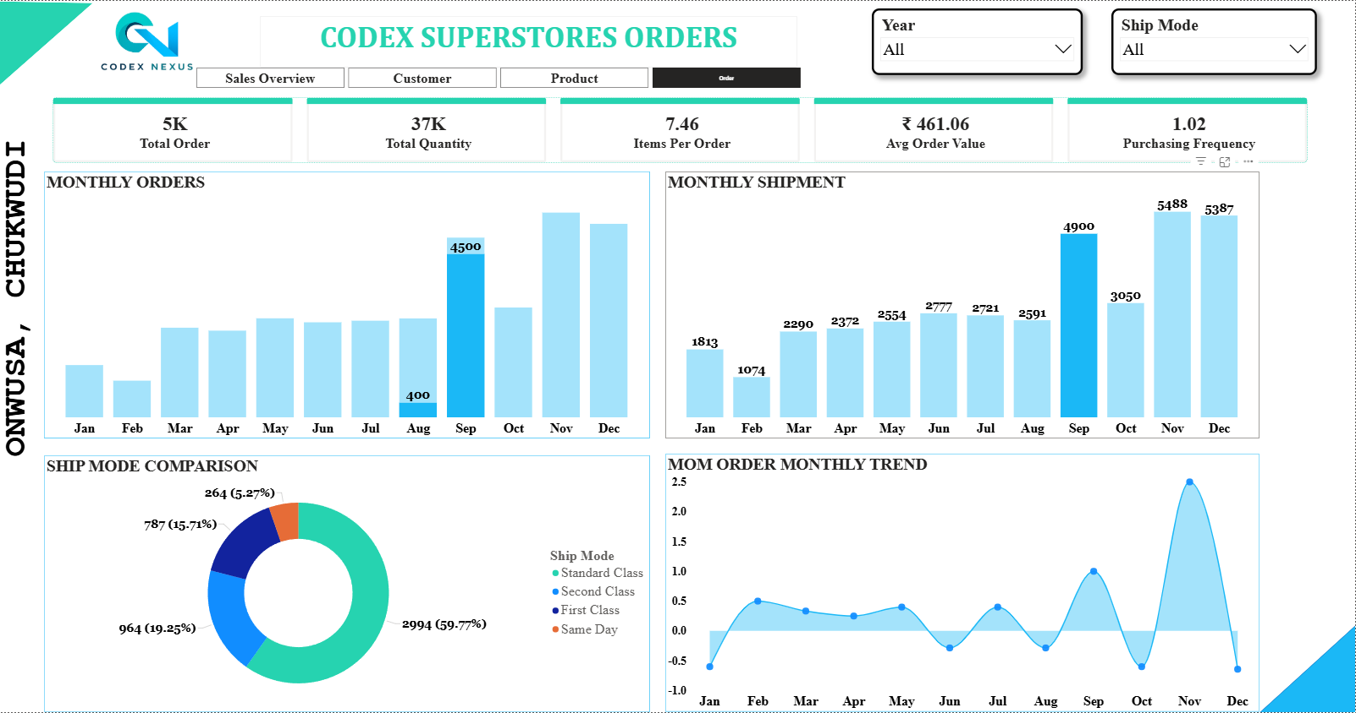
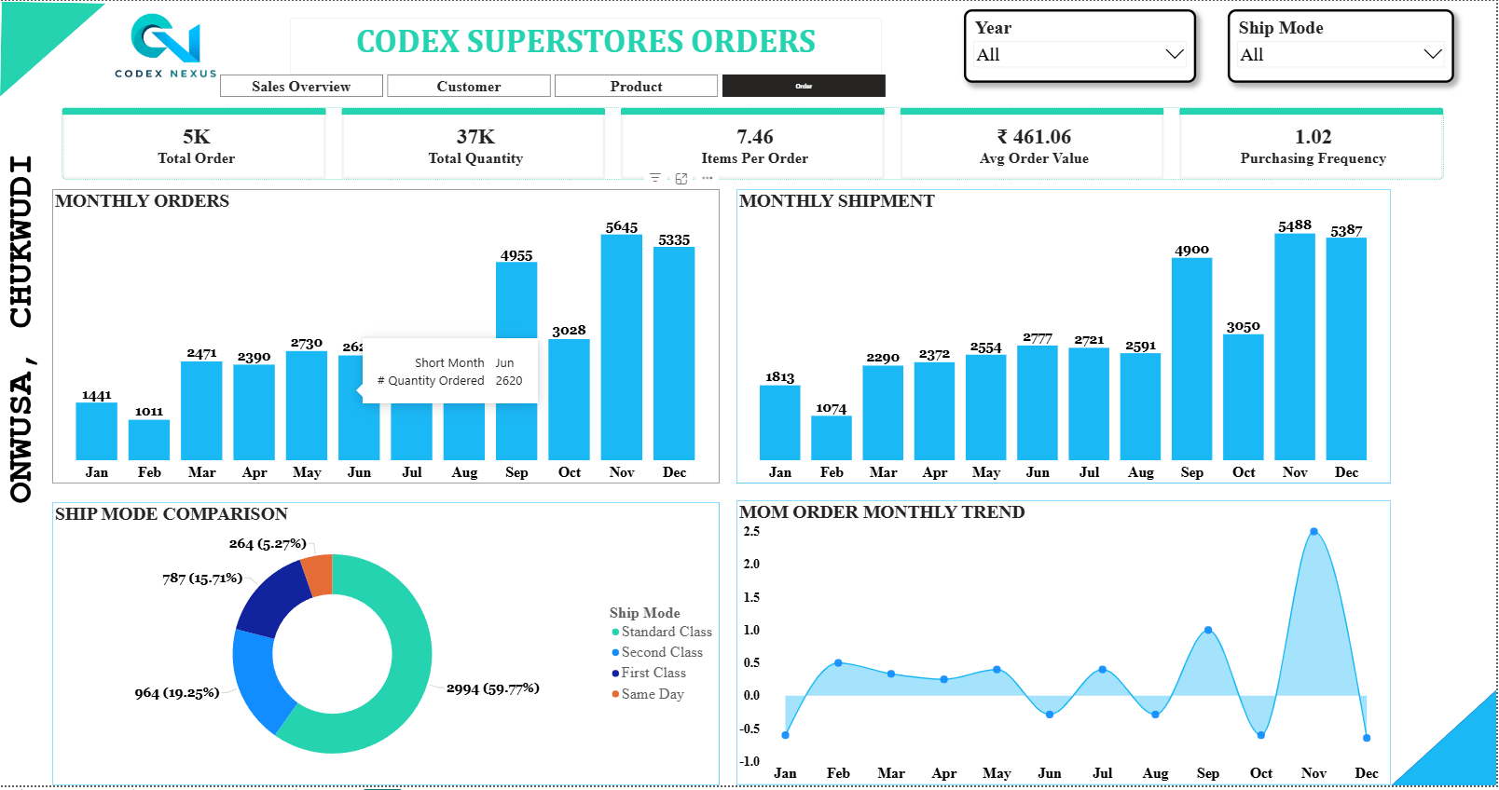
DASHBOARD SCREENSHORTS
OVERVIEW
CUSTOMER VIEW
PRODUCTS VIEW
ORDERS SHIPPMENT INTERATIVENESS
ORDERS SHIPPMENT INTERATIVENESS
ORDERS VIEW

Slide 7
KEY INSIGHTS
Key Insights
Sales Overview
The business generated ₹2.29M in revenue and ₹284.46K in profit, achieving a healthy 12.44% profit margin, well above the typical retail benchmark of 2–5%.
Business performance is highly seasonal, with revenue and profit peaking during the October–December festive period.
Technology was the strongest-performing category, contributing 36.53% of revenue and 51.23% of total profit.
Customer Analysis
Revenue is driven more by customer spending power than customer volume, as Technology generated the highest sales despite having the lowest customer count.
Customer retention is low, with a Repeat Customer Rate of only 1.93%.
Out of 4,865 customers, 98.07% purchased only once, indicating strong reliance on new customer acquisition.
Product Analysis
Revenue and profit are concentrated among a small number of high-performing products.
92 products were purchased only once, suggesting opportunities for inventory optimization and product rationalization.
Order & Shipment Analysis
Order and shipment volumes increase together, indicating efficient operational scalability.
Customers overwhelmingly prefer Standard Class shipping, highlighting a preference for cost-effective delivery options.
Recommendations
Prioritize investment in Technology products due to their superior revenue and profit contribution.
Implement customer loyalty and retention strategies to increase repeat purchases.
Review low-performing products and optimize inventory allocation toward high-demand items.
Prepare inventory and logistics resources ahead of peak seasonal periods.
Expand successful sales strategies from top-performing regions into underperforming markets.
Continue optimizing Standard Class shipping to maintain cost efficiency and customer satisfaction.

Slide 8
CHALLENGES FACED
Data Challenges
Missing values, inconsistent datatype, duplicate value
Modelling Challenges
Building a star schema, managing date dimension ( active and inactive relationship for shipping and ordered date), DAX calculation
SOLUTIONS
Data cleaning in power query and Excel,
Dimension Table Creation,
Relationship optimization, and
Time intelligence Measure
CONCLUSION
SUMMARY
This dashboard successfully transformed raw transactional records into meaningful business insight, providing a scalable and intelligent dashboard that enables management to monitor performances, identify opportunities, and make informed strategic decisions.
BUSINESS VALUE
Improved visibility into sales performance
Better customer behavior understanding
Enhanced product profitability Analysis
Faster decision-making through interactive reporting

